Slide 1
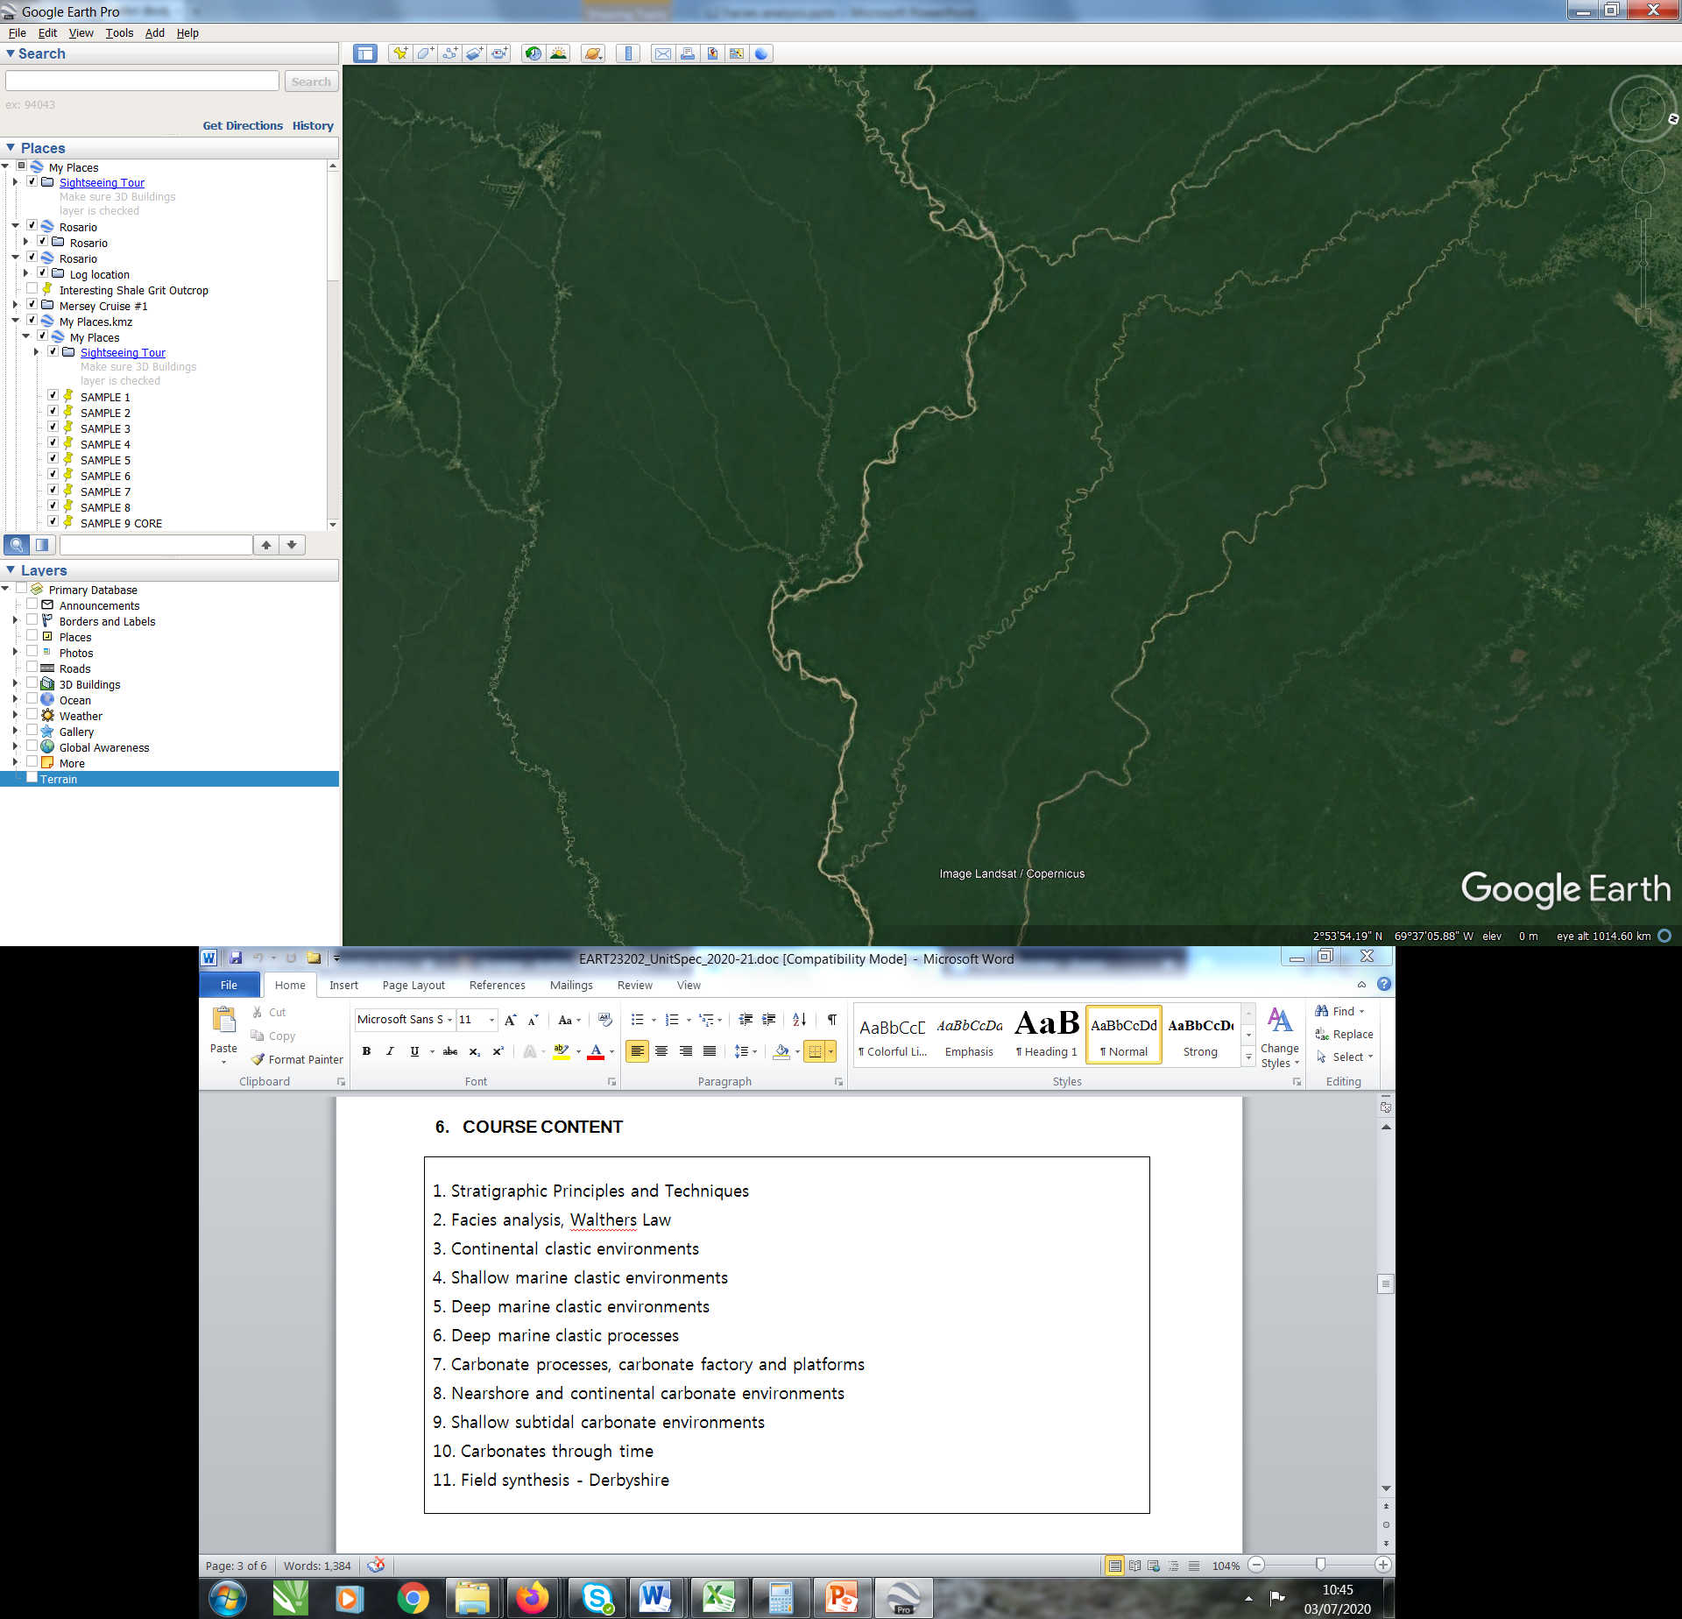
Facies and Facies analysis
EART23202, Ian Kane.

Slide 2
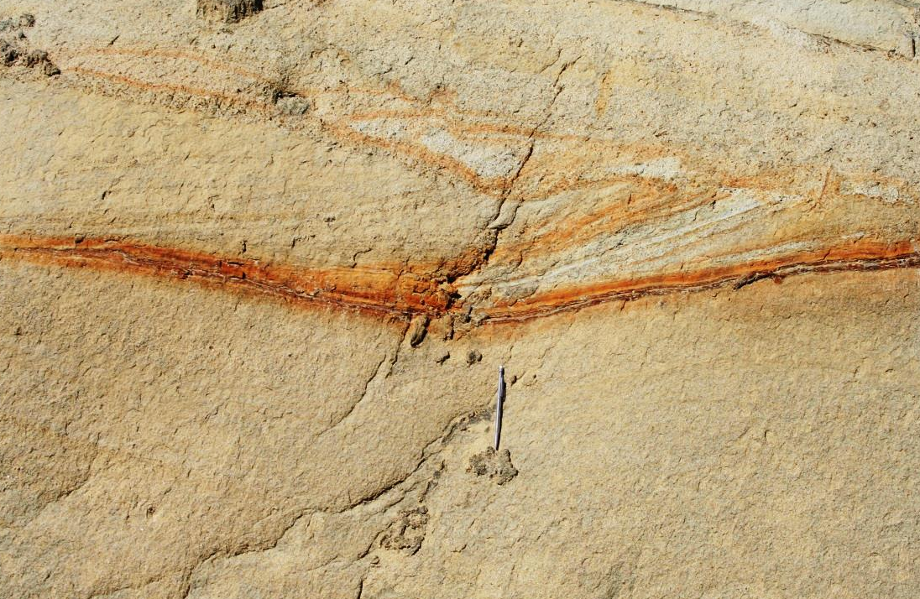
Facies
Facies: a body of sediment or rock characterised by a particular combination of lithological, physical and biological characteristics that distinguishes it from units above, below or adjacent to it.
What descriptors might we use?
Grain type and composition
Texture (grain size, sorting, roundness)
Sedimentary structures
Colour
Biological structures and content (traces fossils, body fossils)
What’s the point of facies?
What determines the scale of facies?
Fan-delta sandstones, Oligocene, St Antonin, France (photo: IK).

Slide 3
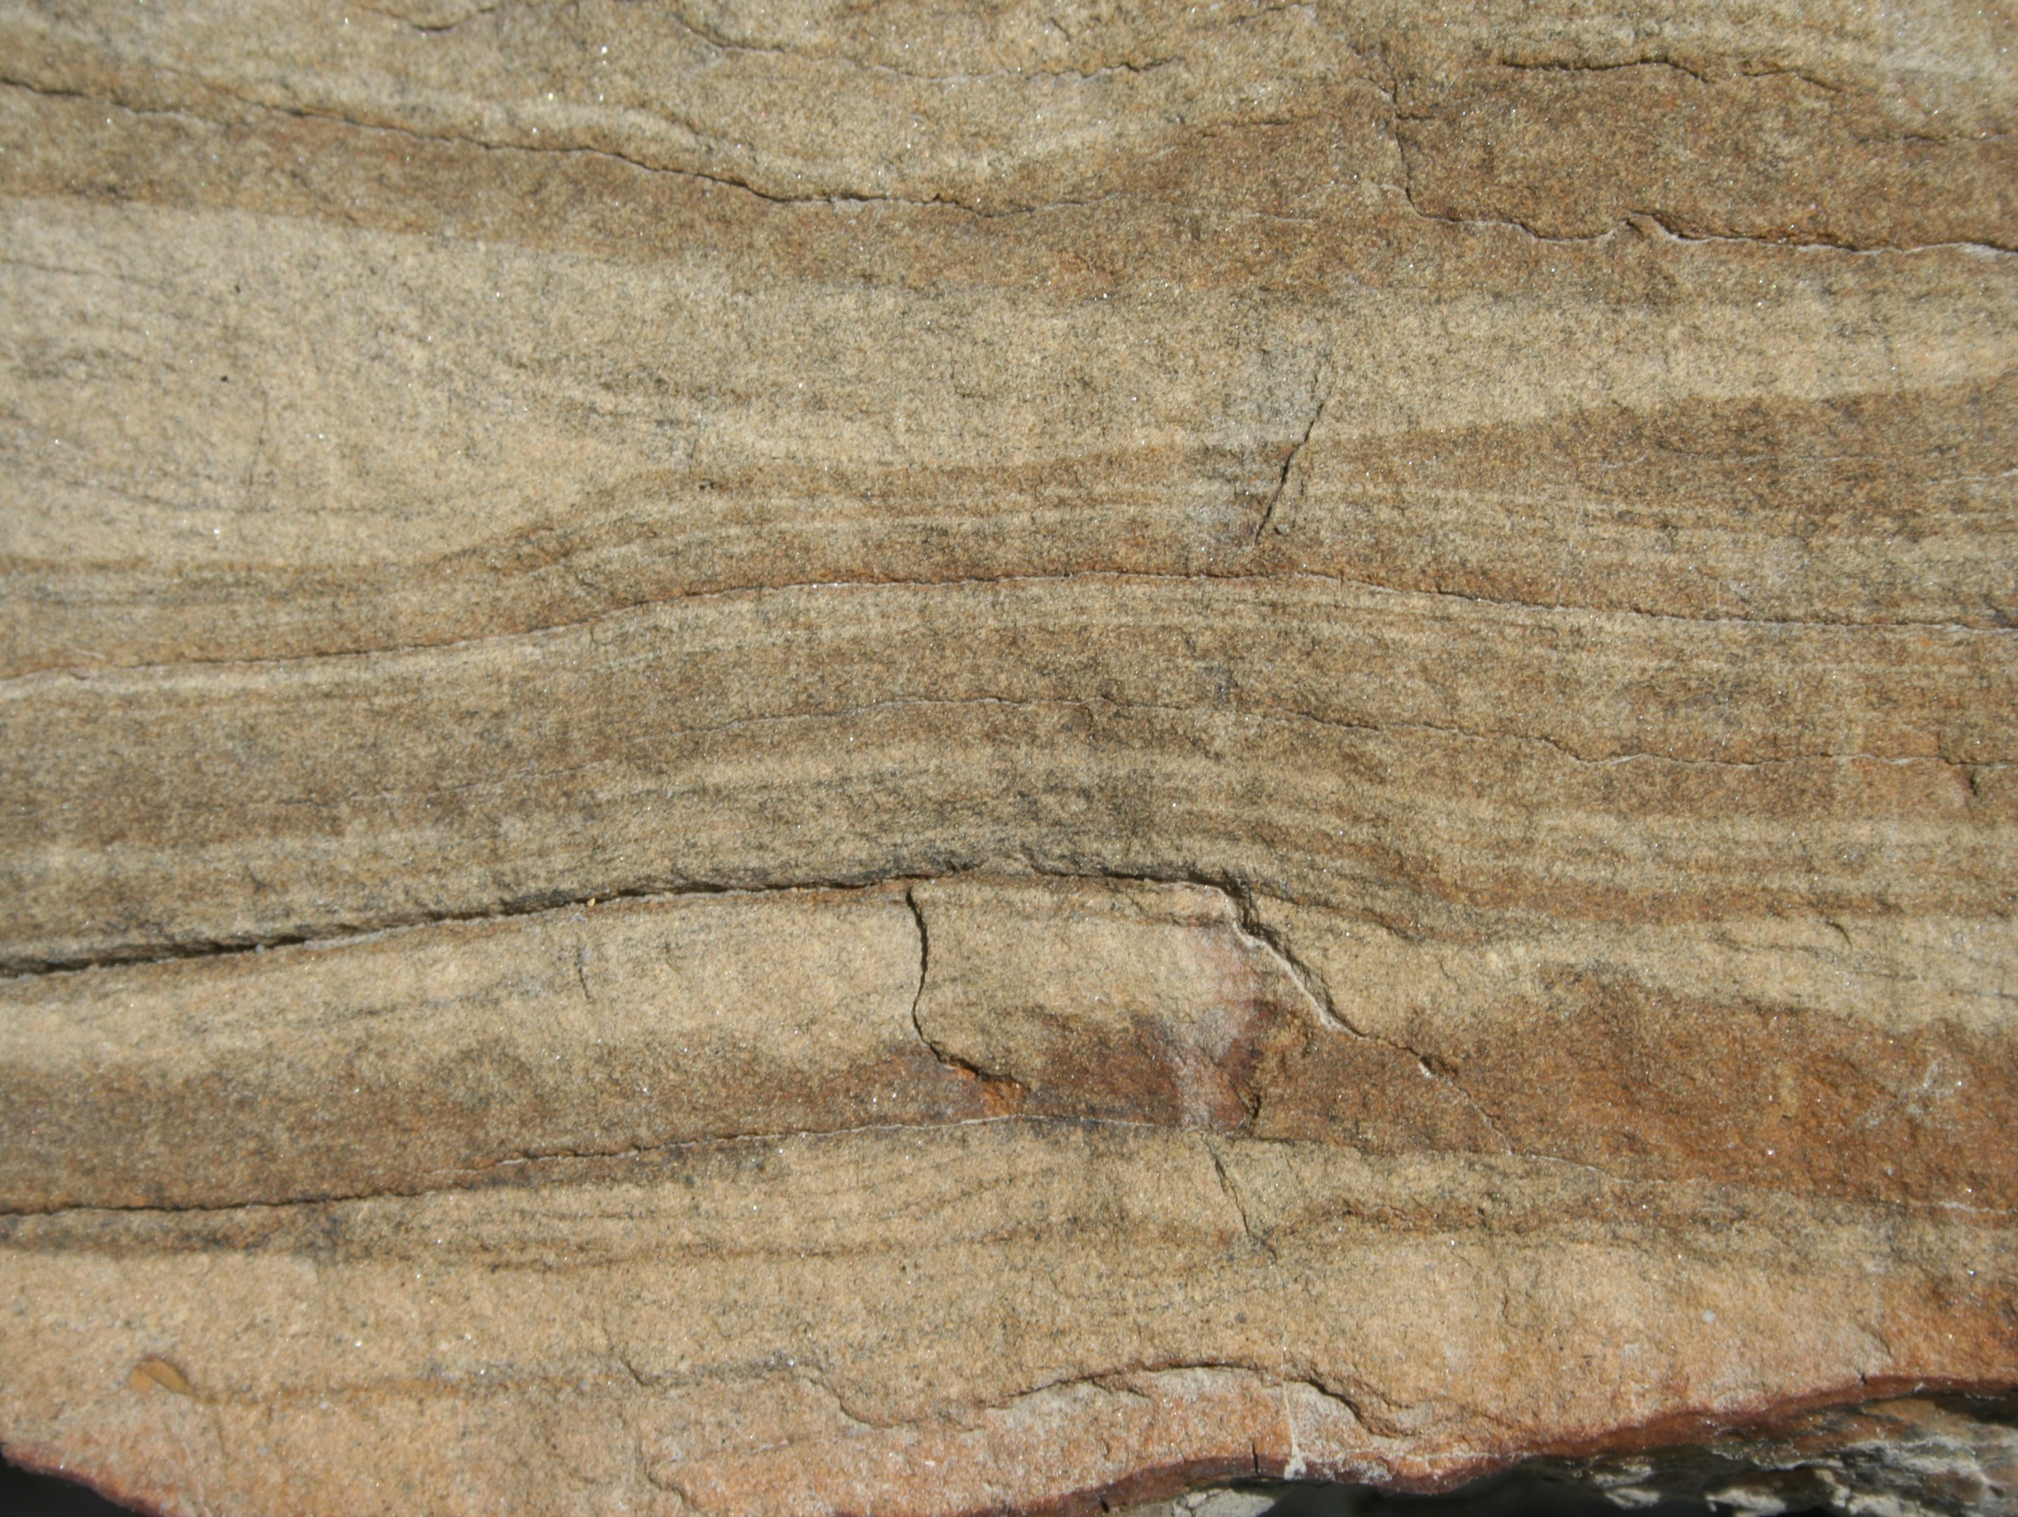
Let’s have a go –what’s this facies?
Gres d’Annot, Annot, S. France (photo: IK).

Slide 4
Let’s have a go – what’s this facies?
Grain type and composition
Quartz, feldspar, mica (sandstone)
Texture
Fine sand <125Mu, well sorted, well rounded
Sedimentary structures
Plane-parallel lamination
Ripple cross lamination
Colour
Beige-brown layers
Biological structures and content (traces fossils, body fossils)
Nothing obvious in this photo
Facies:
Fine-grained, laminated and cross laminated sandstone

Slide 5
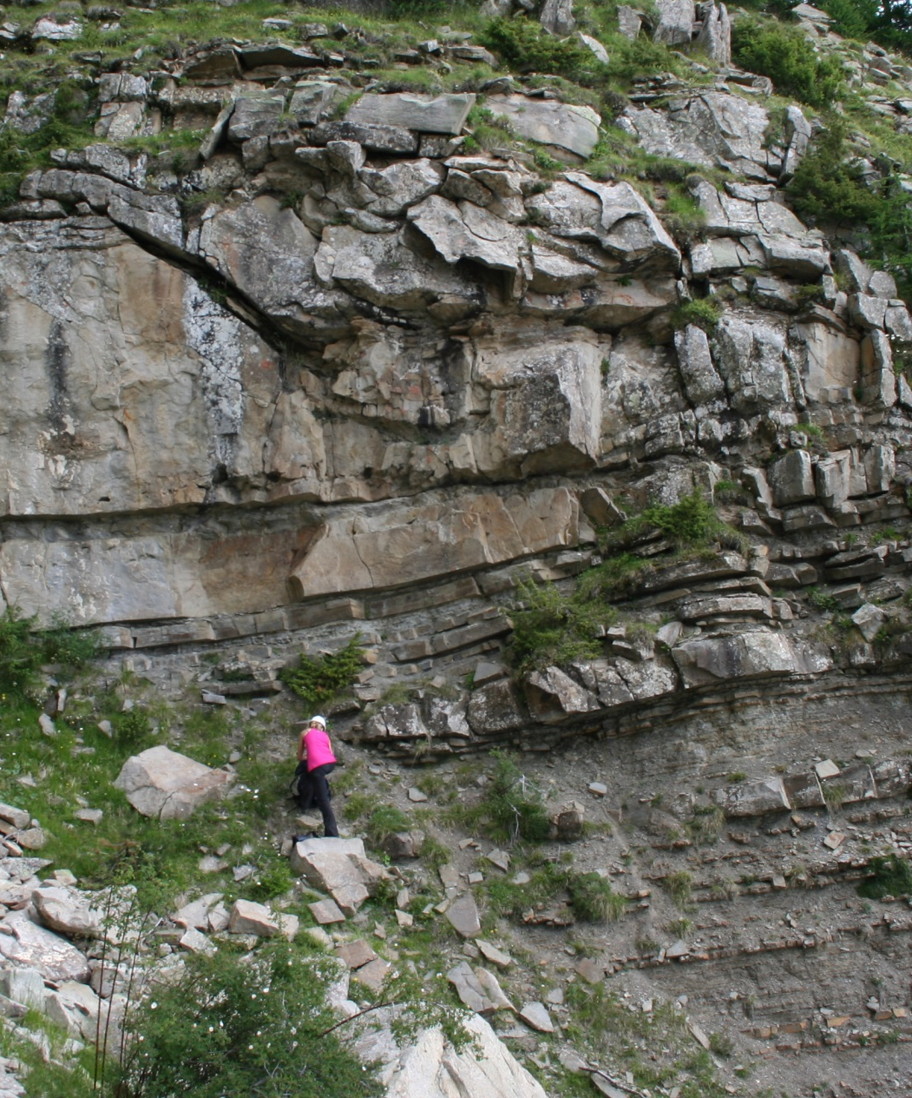
We have defined a ‘lithofacies’
The facies name we chose reflects the characters of the rock that are observable
What does it tell us? It gives us a bucket into which we can put similar observations when rapidly logging or mapping, or following more detailed section measurements.
We can use this facies subdivision to analyse vertical and or lateral trends in the distribution of facies
What scale does facies apply to?
Gres d’Annot,Chalufy, S. France (photo: IK).

Slide 6
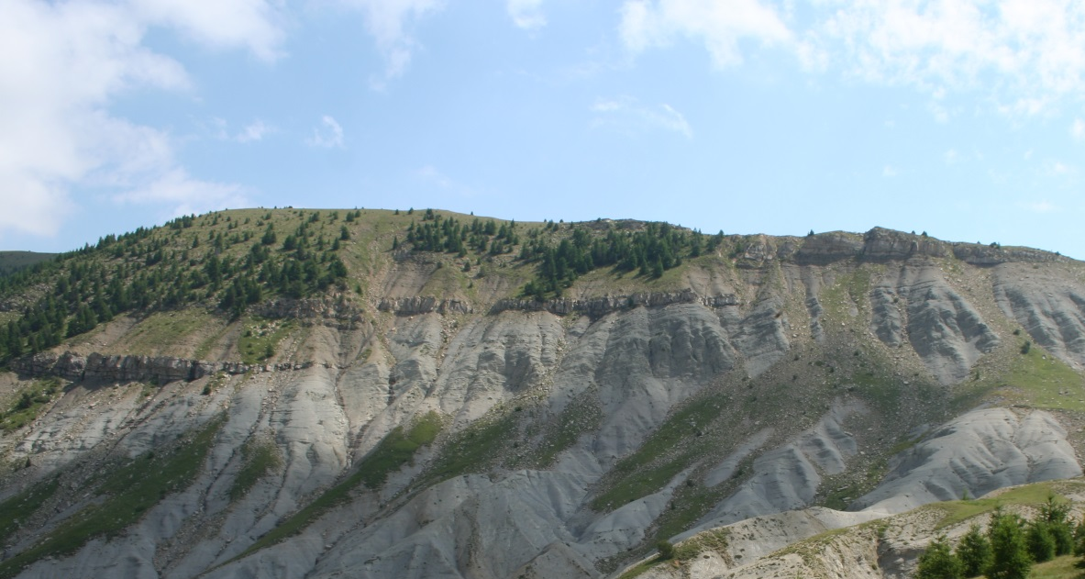
Scale
What are we trying to achieve?
  Broad, arm-wavy discussion
  Regional mapping
  Quantified characterisation of facies distribution? For what purpose?
The scale is arbitrary and driven by pragmatism (time, effort, money, and the ultimate purpose of the work)
>Entire exposure = clastic facies
>>Can be split into 2: Carbonate mudstone and Siliciclastic sandstone facies
>>>Siliciclastics can be split into 2: Thinly-bedded sandstone facies and thickly bedded sandstone facies
>>>>Thinly bedded facies can be split into many varieties, for example: Fine-grained, laminated and cross laminated sandstone

Slide 7
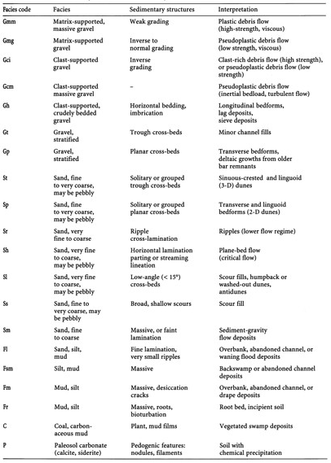
Facies and problems
Facies are defined based on observations
It is commonly suggested that a single facies type is characteristic of a depositional environment BUT facies often non-unique
It is therefore more logical to tentatively assign processes to individual facies
Bear in mind that similar facies may be created by different processes!
A typical facies scheme

Slide 8
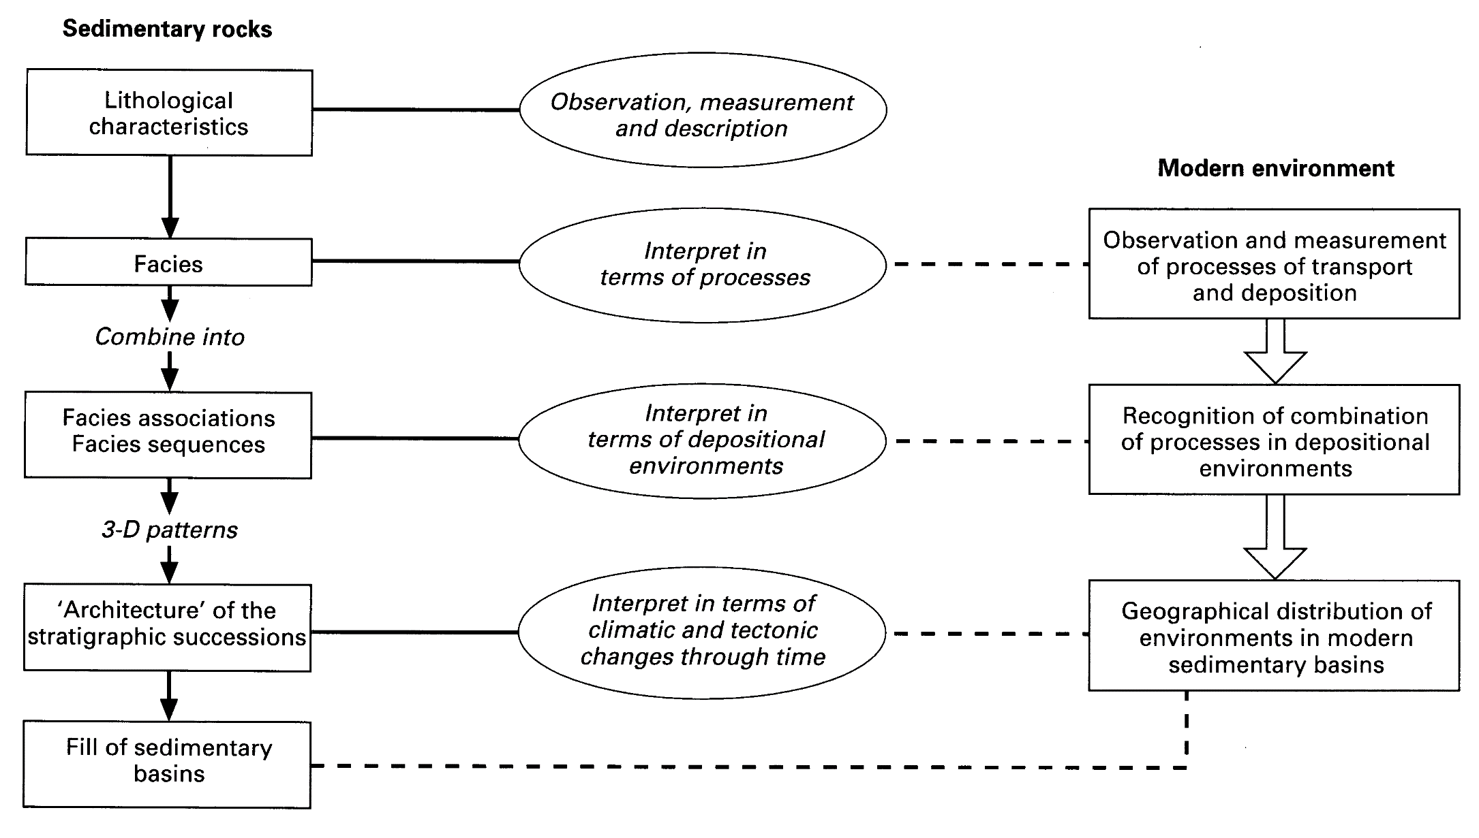
Facies to environment
Notes:
In science, it is critical to distinguish between data (what’s there - lithofacies) and interpretations (how you think it got there – depositional environment).

Slide 9
Facies Associations
Definition: a collection of multiple, genetically-related facies formed within a single depositional system.
Now we are adding an interpretation, based on our process interpretation plus environmental interpretation & actual data, e.g. fossils.
House of cards anyone?

Slide 10
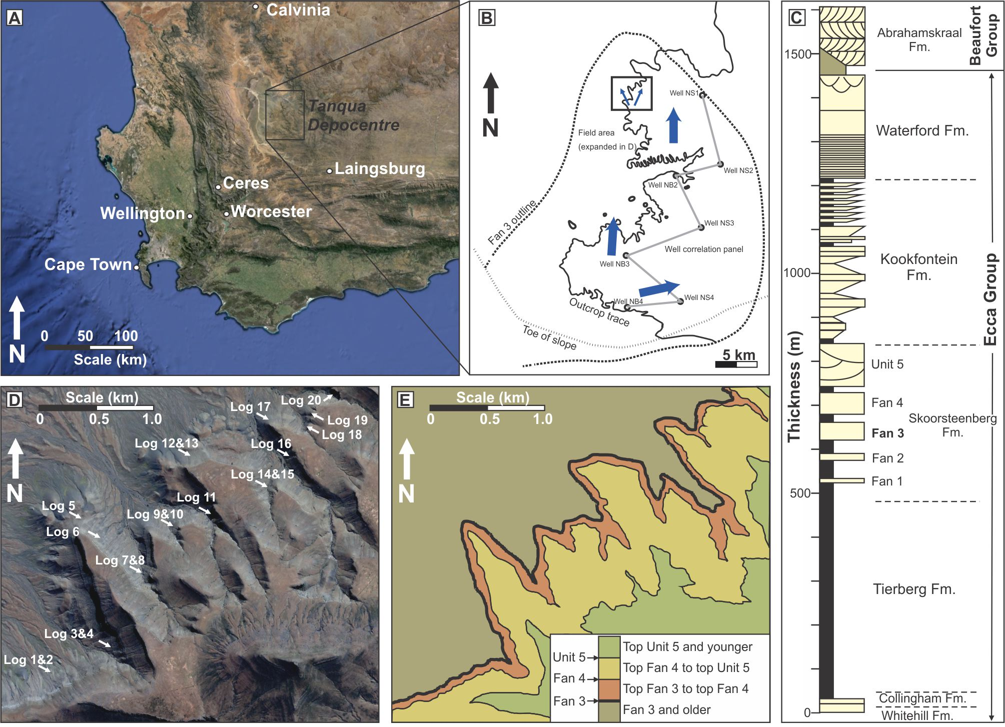
Facies Associations - example
For details see Kane et al. (2017) Sedimentology. – Paper is on Bb
Notes:
I don’t use my own papers because I’ve got a huge ego, it’s because I know them best!

Slide 11
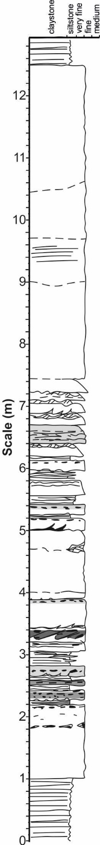
Facies Associations - example
For details see Kane et al. (2017) Sedimentology. – Paper is on Bb

Slide 12
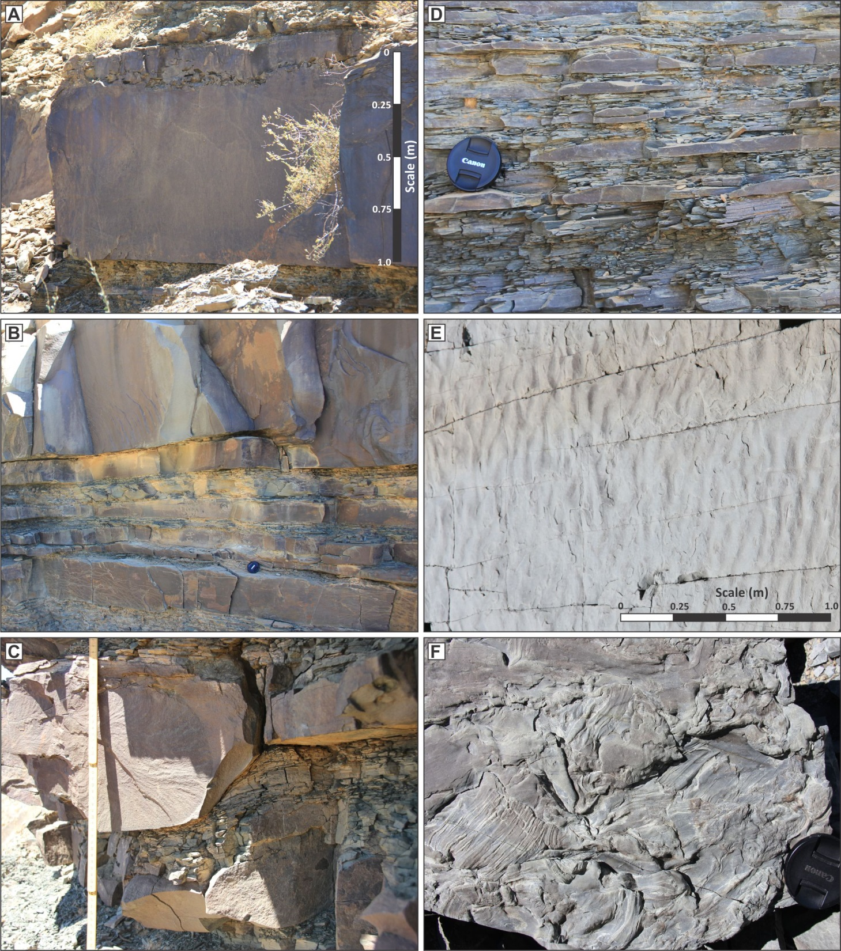
Facies Associations
Notes:
Representative turbidite facies. (A) Thick-bedded turbidite with a sharp base, weak normal grading and
with a clast-rich upper part; clasts are partly disaggregated generating clay-rich patches within the sandstone.
(B) Erosional bed bases typically plane out on mudstones and cut downward in a stepwise manner through
thin-bedded intervals, occasionally with contemporaneous lateral injection. (C) Erosional step at base of med-
ium-bedded sandstone which is loaded into underlying thin-bedded silty turbidites. (D) Thin-bedded very fine-
grained low-density turbidites. Lens cap is 55 mm in diameter. (E) Rippled bed top to low-density turbidite. (F)
Plant imprints in an intra-bed division.

Slide 13
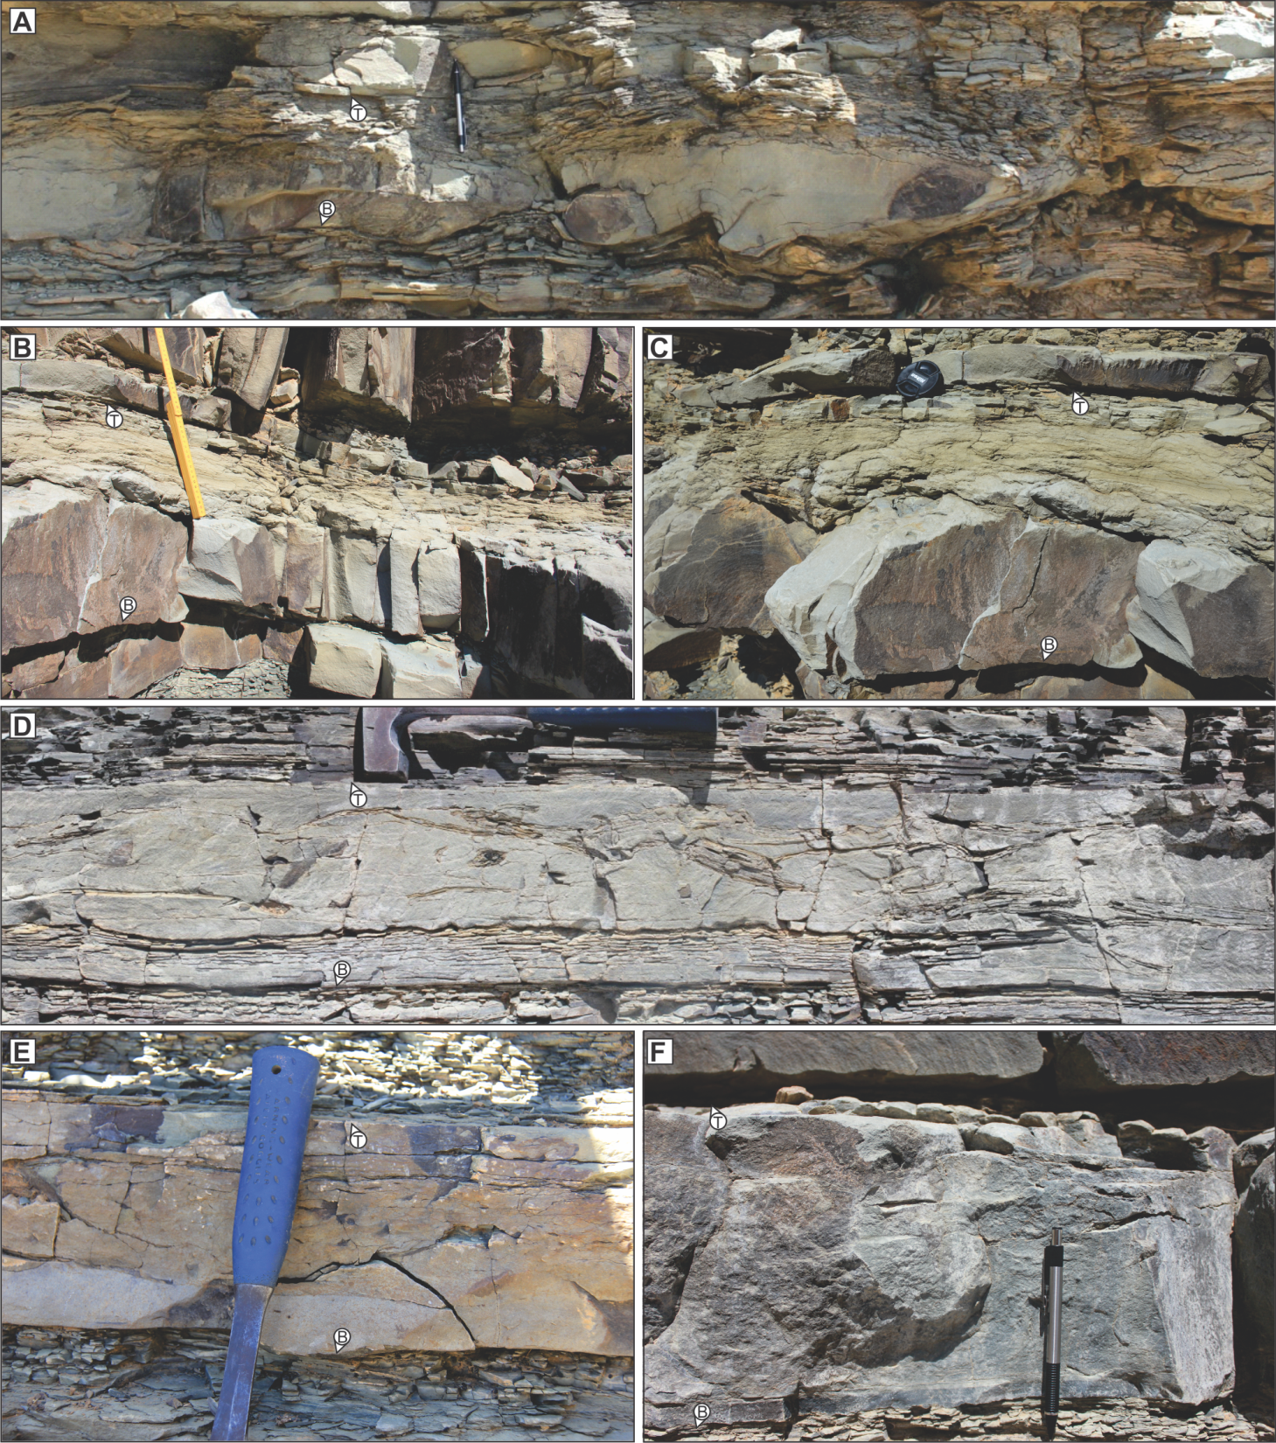
Facies Associations
Notes:
Representative hybrid-bed photographs (‘B’ and ‘T’ symbols indicate base and top of beds). (A) Bed showing
intense interaction with the substrate and muddy upper part, these are typical in medial lobe settings. Pencil is 145
mm long. (B) and (C) Hybrid beds with thick laminar/high-concentration flow deposits in their upper parts; these are
typical in medial to distal settings. Lens cap is 55 mm in diameter. (D) Hybrid beds with large rafts of siltstone and
mudstone. (E) and (F) Thin hybrid beds characteristic of the distal facies, with thin relatively clean sands at bed
bases and overlying layers of varying mud content. Hammer handle is 150 mm long.

Slide 14
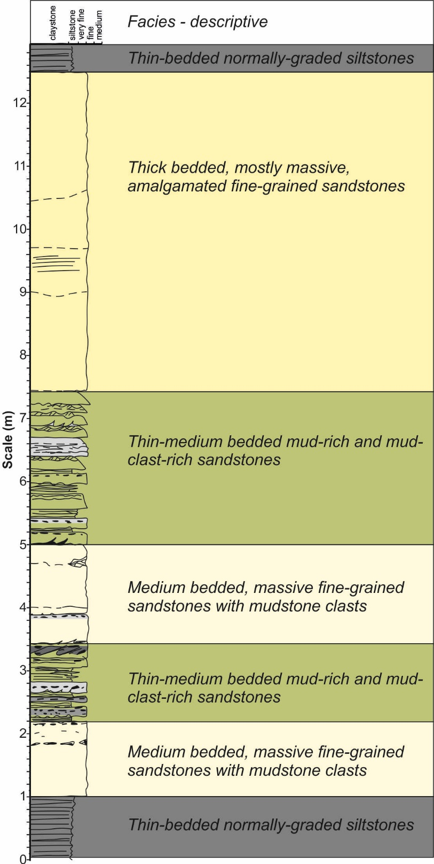

Slide 15
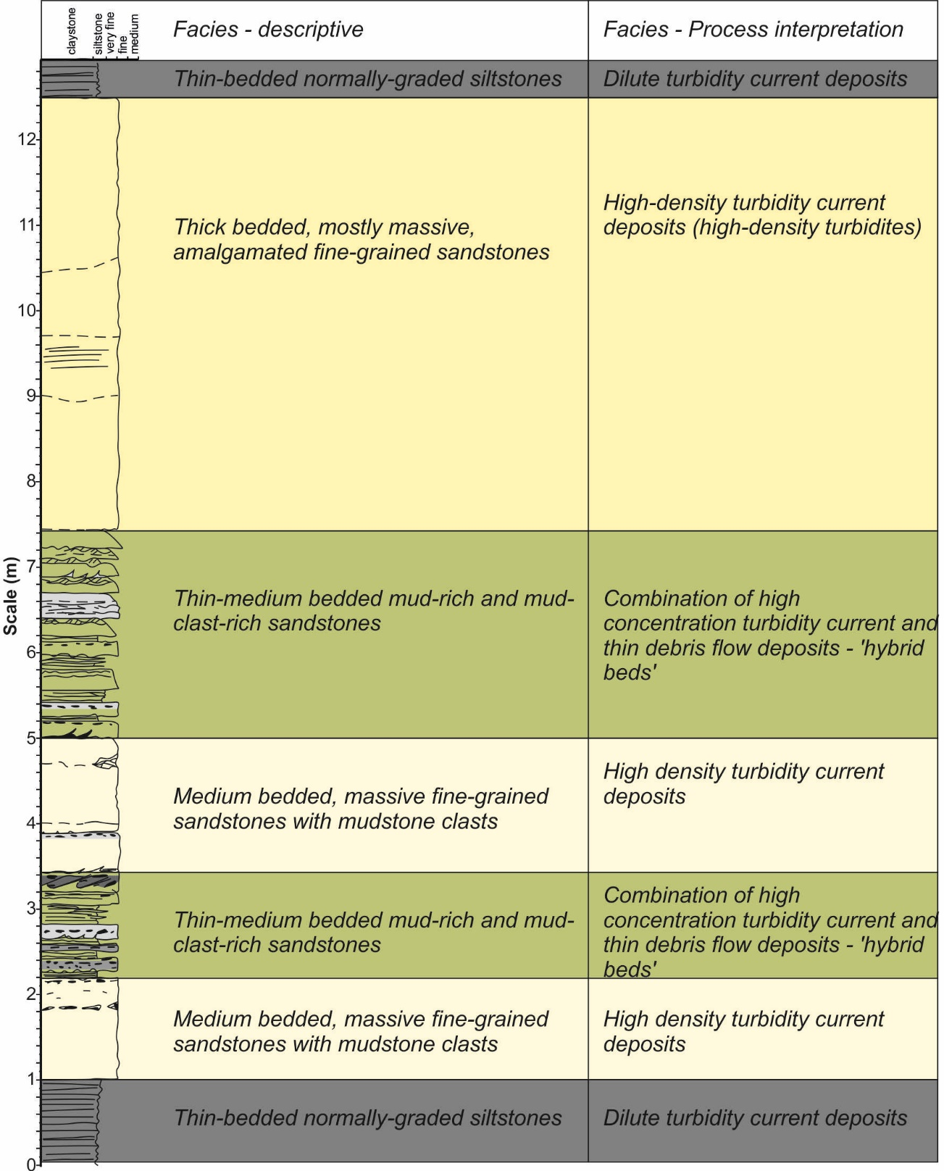

Slide 16
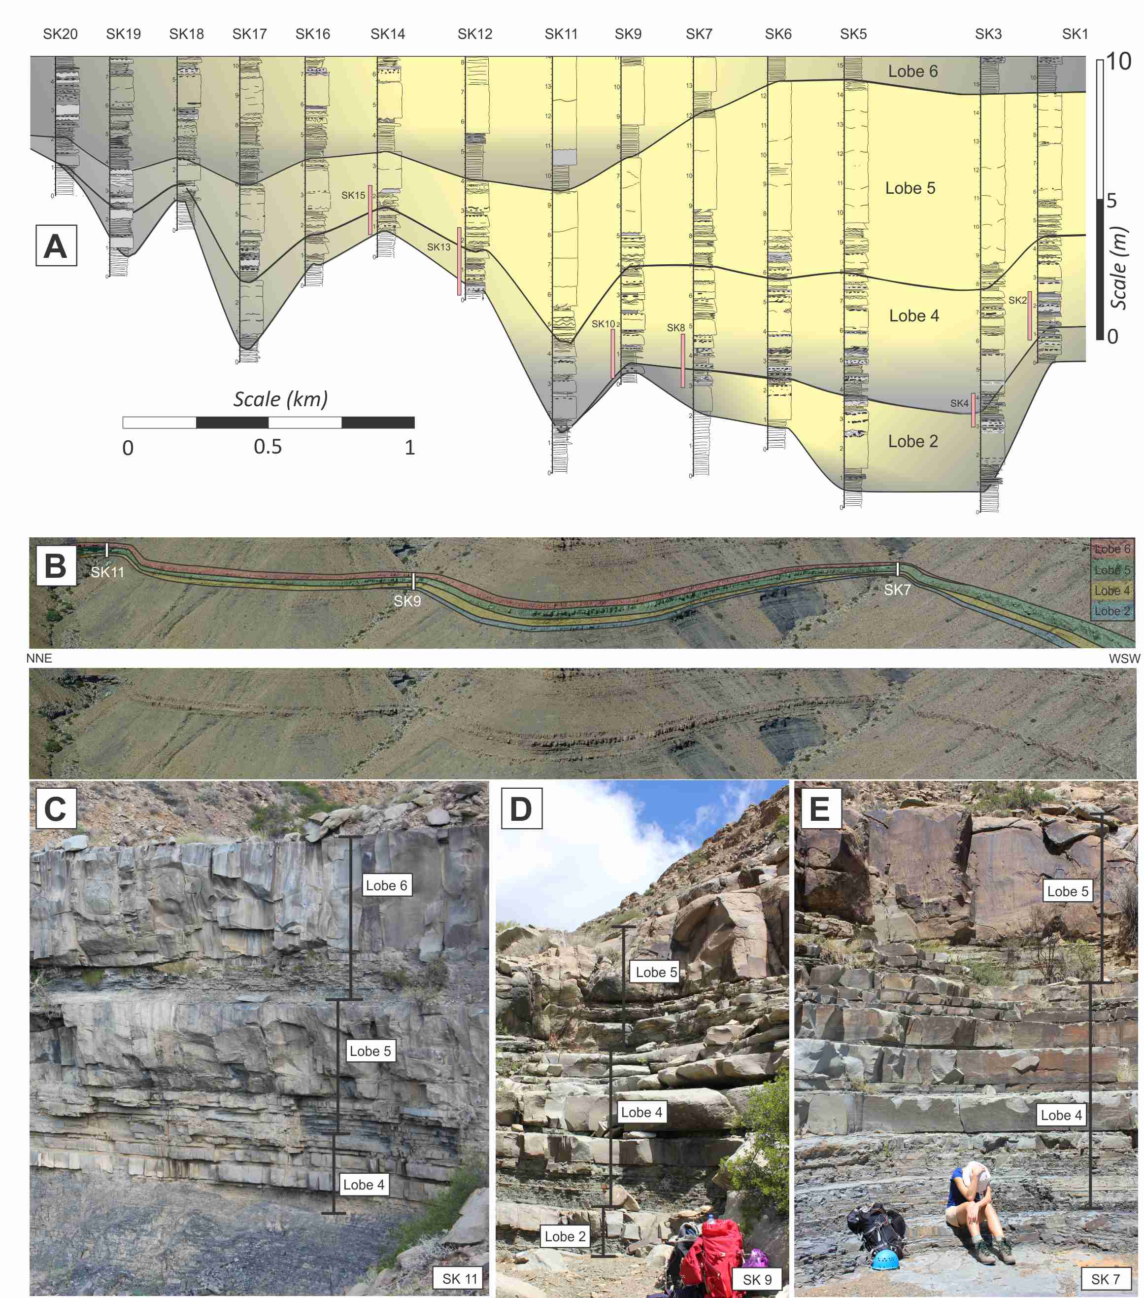
Facies Associations - context

Slide 17
Facies Associations - context

Slide 18
How do we make the leap to an environmental interpretation?
Analogues:
Modern
Ancient
Theoretical
Experimental

Slide 19
Marine
No major erosion
Widespread near tabular beds
Decelerating turbidity currents
Deposits pinch out (wedge)
Must be terminal part of the system
Facies Association:
Deep-marine lobe

Slide 20
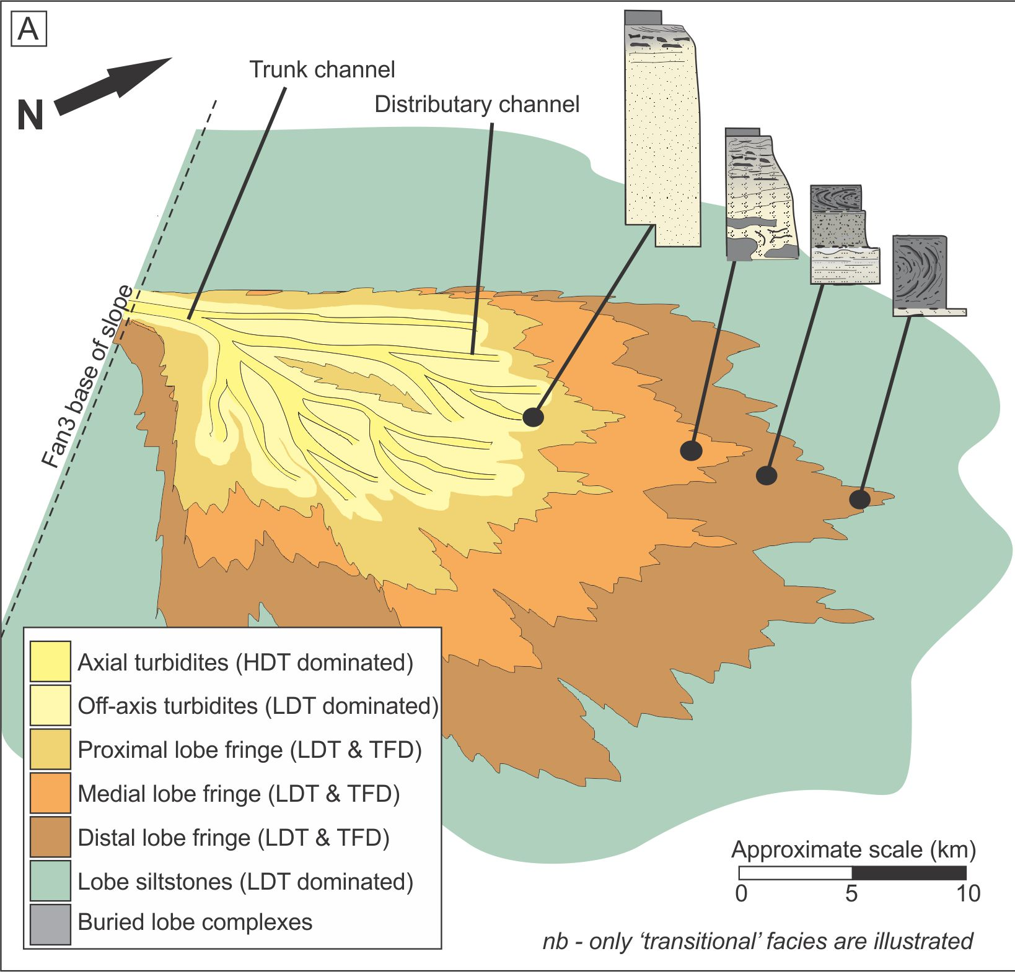
Deep-marine lobe Facies Association
Facies association: a collection of multiple, genetically-related facies
formed within a single depositional system.

Slide 21
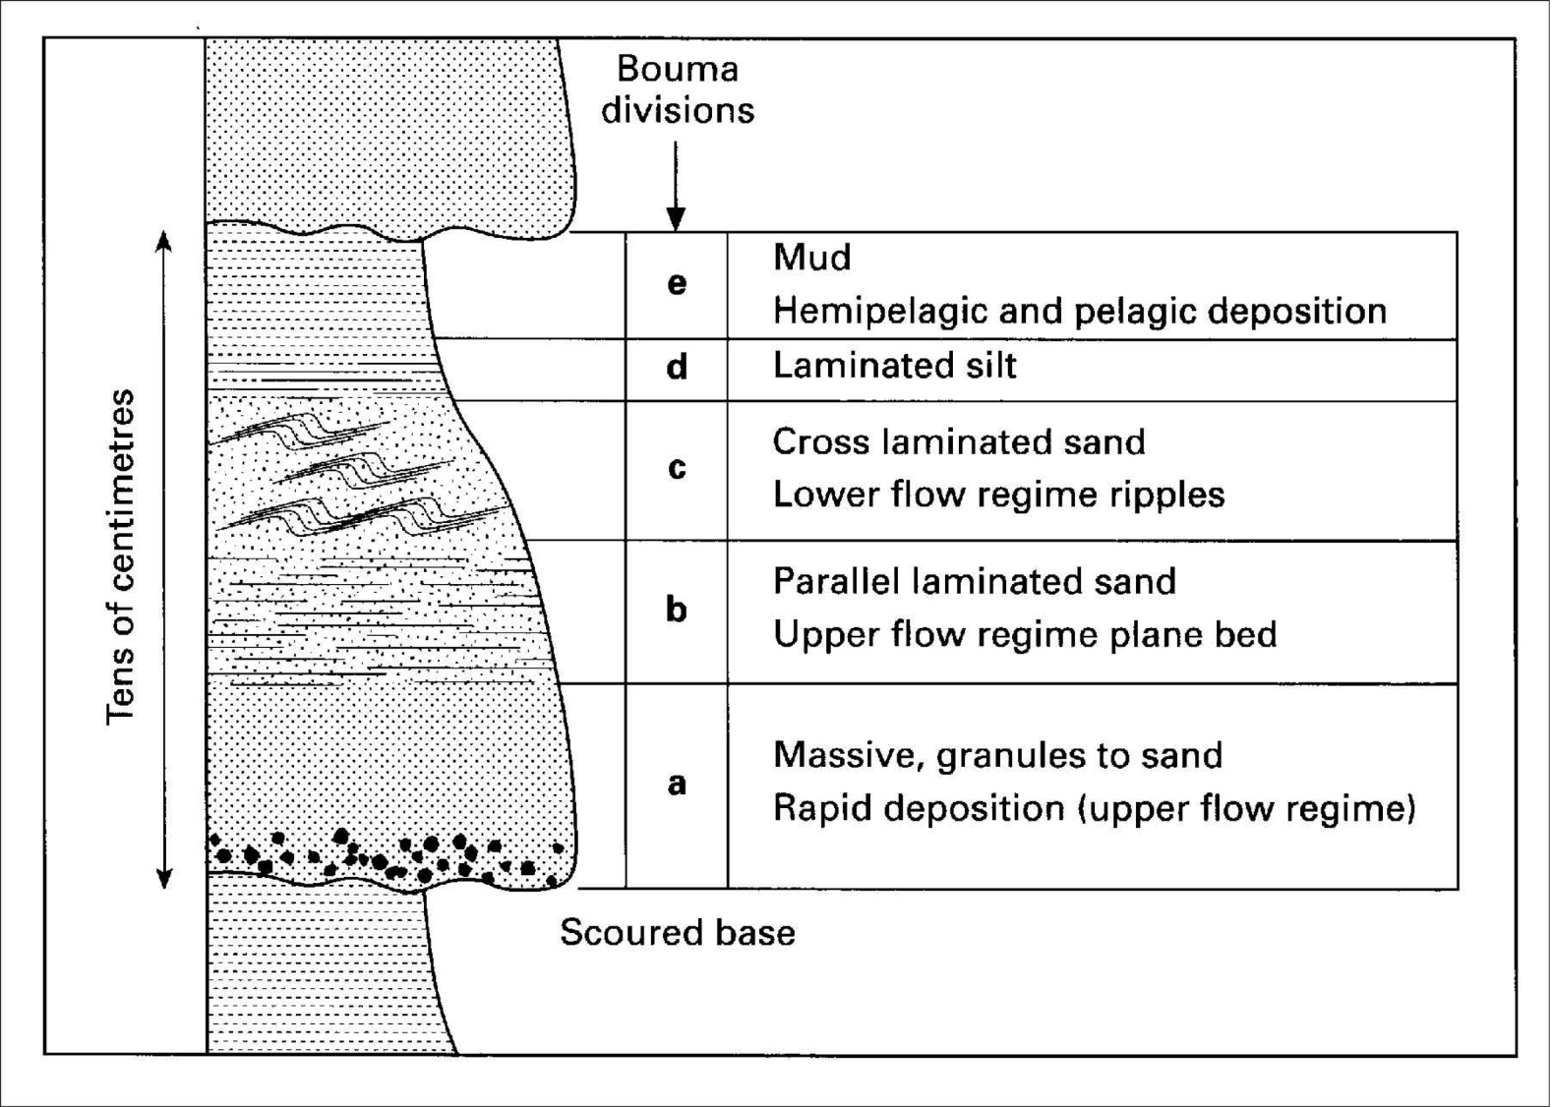
Bed scale facies associations
Some facies associations are found repetitively in the stratigraphic record and, therefore, have informally been given names, such as the Bouma sequence. Often thought of as synonymous with ‘turbidite’ but it’s just one collection an organisation of these facies

Slide 22
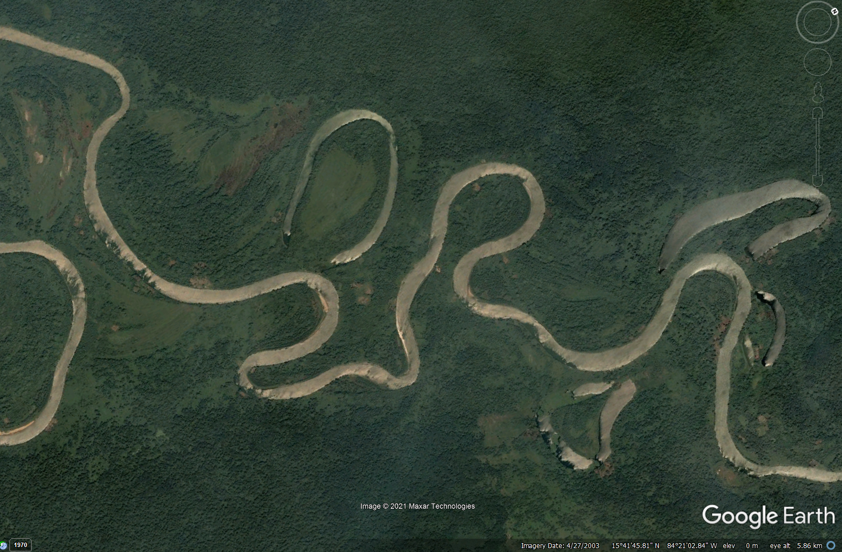
Typical ‘point-bar’ facies association

Slide 23
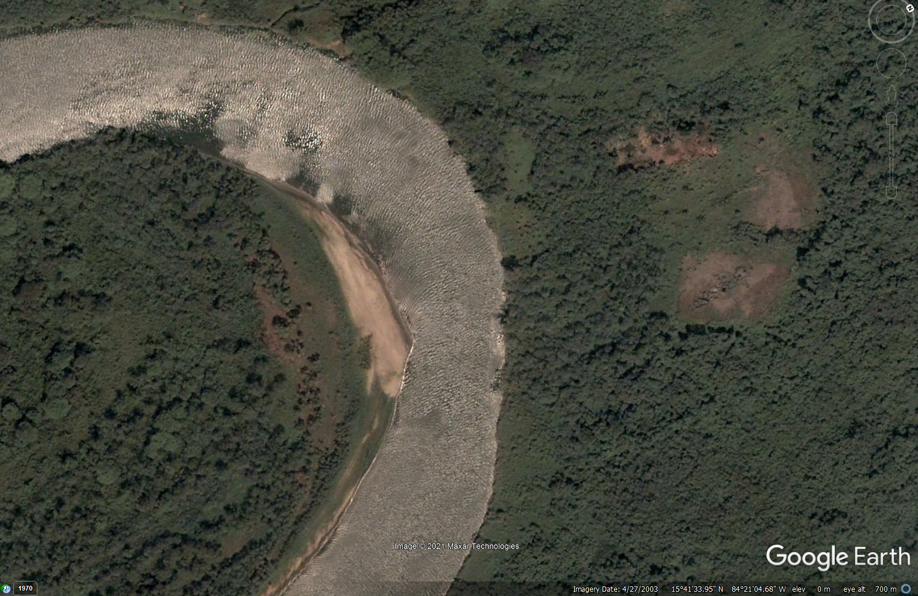
Typical ‘point-bar’ facies association
Cut bank
Point Bar

Slide 24
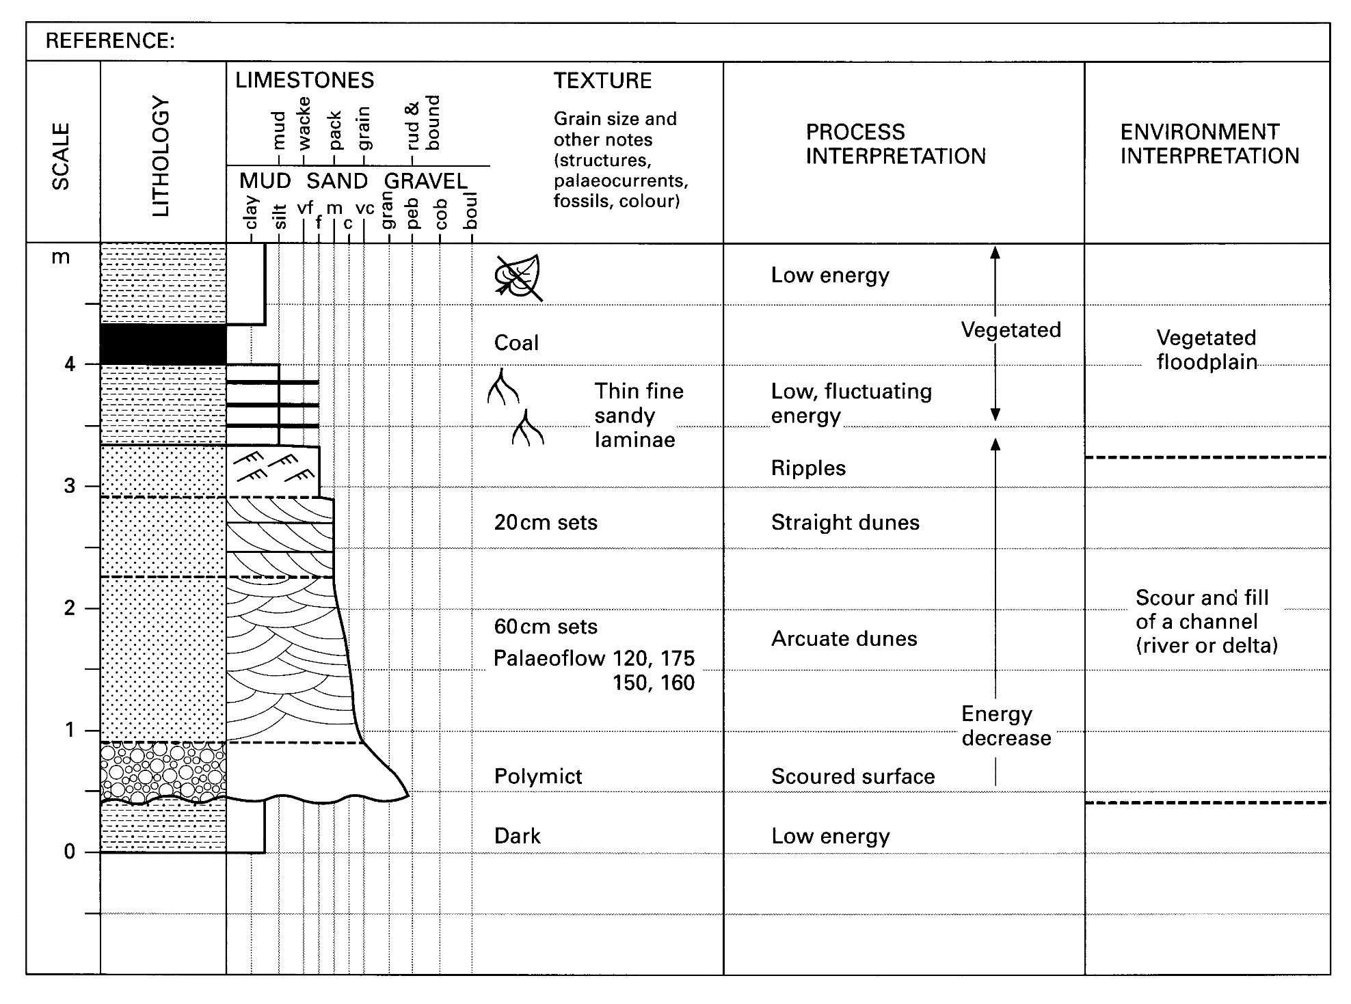
Typical ‘point-bar’ facies association

Slide 25
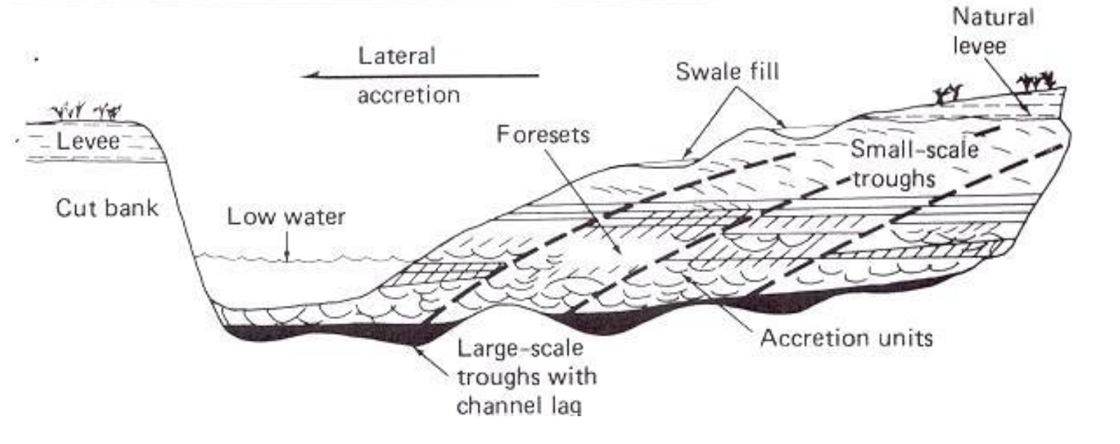
Cross Section of Point Bar. At any point in time in the natural history of a meandering stream system, each of the environments in a point bar sequence is present, including channel lag, fining upwards sand accretions, and ridge and swale topography on the surface. As the channel migrates laterally, the sequence accumulates and is eventually buried beneath overbank material such as natural levee sediments. (From Davis 1983, p. 256)

Slide 26
Stratigraphy and Walther’s Law
‘The various deposits of the same (environmental) area and, similarly, the sum of the rocks of different environmental areas were formed beside each other in time and space, but in crustal (i.e. vertical) profile we can see them lying on top of each other….it is a basic statement of far-reaching significance that only those environmental areas can be superimposed that are observed side-by-side at the present time’
Walther’s Law 1894.

Slide 27
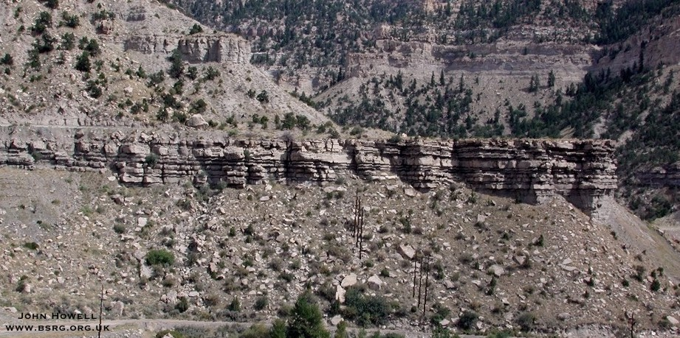
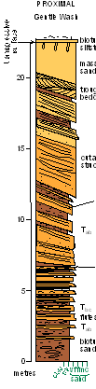
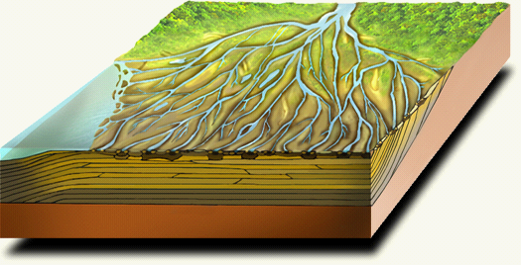
Walther’s Law: Applied to progradation of a river delta
seaward
Dipping clinoform
10 m
The vertical succession records the
outbuilding of (in this case) a river
delta, over time, past a fixed point
in space. Therefore the beds above
each other represent depositional
areas that were laterally adjacent

Slide 28
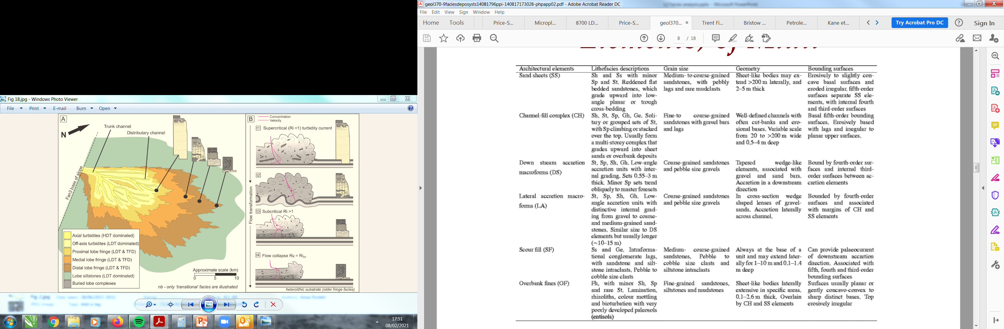
Facies Associations to Architectural elements
Miall (1985) formalized facies associations for fluvial systems. These are used
widely (with modification).

Slide 29
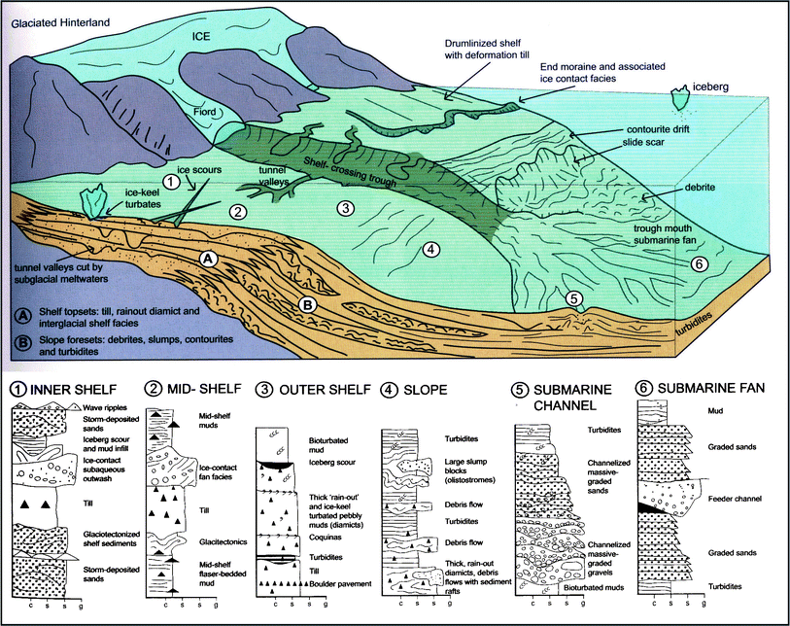
Overview
Facies Associations from a glaciated margin (Miall, 2015)

Slide 30
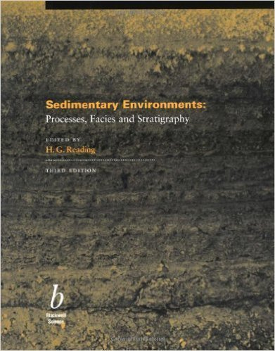
Summary
Facies: a body of sediment or rock characterised by a particular combination of lithological, physical and biological characteristics that distinguishes it from units above, below or adjacent to it.
a collection of multiple, genetically-related facies formed within a single depositional system.
Always separate and make it clear – what is an observation and what is an interpretation!
Recommended Reading: Sedimentary Environments (Harold Reading)

